Slide 1
More on Prolog
Lecture P2 – CS352

Slide 2
Arithmetics
Arithmetic operators
+, -, *, /, // (integer division)
Infix notation
x+y*z
Evaluation of arithmetic expressions
?- 7 is 3+4.
true
?- 8 is 3+4.
false
Arithmetic comparison relations
<, =<, =:= (equal), =\= (different), >=, and >
note: = (unifies with)
?- 6*2 =:= 3*4.
true
?- 7 > 3+4
false

Slide 3
Arithmetic Application
Factorial numbers (n!) can be calculated using the following Prolog program
%factorial(N,F): F=N! (this is comment line)
factorial (0,1).
factorial (N,F) :- N>0, N1 is N-1, factorial(N1,F1), F is N*F1.

Slide 4
Revisit quad.pl
%simplified quad equation ax^2+bx+c=0 solution.
%Simplification: if a = 0, or b^2-4*a*c<0 let x1=0, x2=0.
quad(0,B, C, 0, 0).
quad(A,B,C, X1, X2) :-
D is B * B - 4 * A * C,
D >= 0,
R is sqrt(D),
X1 is (-B + R) / (2 * A),
X2 is (-B - R) / (2 * A).
quad(A,B,C, X1, X2) :-
D is B * B - 4 * A * C,
D < 0,
X1 is 0,
X2 is 0.
Any problem?

Slide 5
Revised quad.pl
%simplified quad equation ax^2+bx+c=0 solution.
%Simplification: if a = 0, or b^2-4*a*c<0 let x1=0, x2=0.
quad(0,_, _, 0, 0) :- !.
quad(A,B,C, X1, X2) :-
D is B * B - 4 * A * C,
D >= 0, R is sqrt(D),
X1 is (-B + R) / (2 * A),
X2 is (-B - R) / (2 * A).
quad(A,B,C, X1, X2) :-
D is B * B - 4 * A * C,
D < 0, X1 is 0, X2 is 0.
Note: A single underscore ( _ ) denotes an anonymous variable and means "any term".

Slide 6
cut
A goal that cannot be backtracked, i.e. other rules are prevented.
G(0, 1) :- !.

Slide 7
Factorial - revisit
fac(0,1).
fac(N,Out) :-
M is N-1,
fac(M,Y),
Out is N*Y.
Any problem with it?

Slide 8
Factorial - revisit
fac(0,1).
fac(N,Out) :-
M is N-1,
fac(M,Y),
Out is N*Y.
Any problem with it?
infinite loop!
why?

Slide 9
Factorial with cut
cut: prevent Prolog from using the second rule in computing fac(0,X).
fac(0,1) :- !.
fac(N,Out) :-
M is N-1,
fac(M,Y),
Out is N*Y.

Slide 10
Another way to prevent infinite loop
fac(0,1).
fac(N,Out) :-
N > 0,
M is N-1,
fac(M,Y),
Out is N*Y.

Slide 11
Disjunction operator
Disjunction of goals
X;Y (meaning X or Y)
Example
person(X) :- (X=adam; X=eve; mother(X,Y)).
(X is a person if X is adam (first possibility), or X is eve (2nd possibility), or X has a mother)
Equivalent to:
person(adam).
person(eve).
person(X) :- mother(X,Y).

Slide 12
Lists
List
Consists of elements of the list separated by commas
The whole list is enclosed in square brackets
Can also be written as [X|Y], X: the head, Y: the tail
Examples
[] (empty list)
[a] (head: a, tail: [])
[a, b, c] (head: a, tail: [b,c])
[the, men, [like, to, fish]]

Slide 13
List Applications
Member
%member(X,Xs): X is a member of list Xs?
member(X,[X|_]).
member(X,[_|Y) :- member(X,Y).
?- member(d,[a,b,c,d,e,f,g]).
true
?- member(2,[3,a,4,f]).
false

Slide 14
Length
%length(Xs,N): N is the length of list Xs
length([], 0).
length([_ | Ts], N) :- length (Ts, M), N is M+1.
?- length([a,b,c], N).
N=3

Slide 15
p([1, 2, 3]).
p([the, cat, sat, [on, the, mat]]).
?-p[X|Y].
X=1 Y=[2, 3] ;
X=the Y=[cat,sat,[on,the,mat]]
?-p([_,_,_,[_|X]]).
X=[the,mat]

Slide 16
Avoiding
Circular definitions
parent(X,Y) :- child(Y,X).
child(A,B) :- parent(B,A).
Infinite definitions
person(X) :- person(Y), mother(X,Y).
person(adam).
?- person(X).

Slide 17
More Example Programs
%ordered(Xs): is the list Xs in ascending order?
ordered([]).
ordered([_]).
ordered([X,Y | Xs] :- X =< Y, ordered([Y|Xs]).

Slide 18
Change for a dollar
Write a Prolog program checks or generates change adding up to a dollar consisting of half-dollars, quarters, dimes, nickels, and pennies.
change([H,Q,D,N,P]) :-
member(H,[0,1,2]), /* Half-dollars */
member(Q,[0,1,2,3,4]), /* quarters */
member(D,[0,1,2,3,4,5,6,7,8,9,10]) , /* dimes */
member(N,[0,1,2,3,4,5,6,7,8,9,10, /* nickels */
11,12,13,14,15,16,17,18,19,20]),
S is 50*H + 25*Q +10*D + 5*N,
S =< 100,
P is 100-S.

Slide 19
Several kinds of goals are possible; for example
?- change([H,Q,D,N,P]).
...
will list all possible ways of giving change for a dollar (try it!), and
?- change([0,2,3,4,6]).
false
since 2 quarters, 3 dimes, 4 nickels, and 6 pennies does not make a dollar, and
?- change([0,2,3,2,P]).
P=10

Slide 20
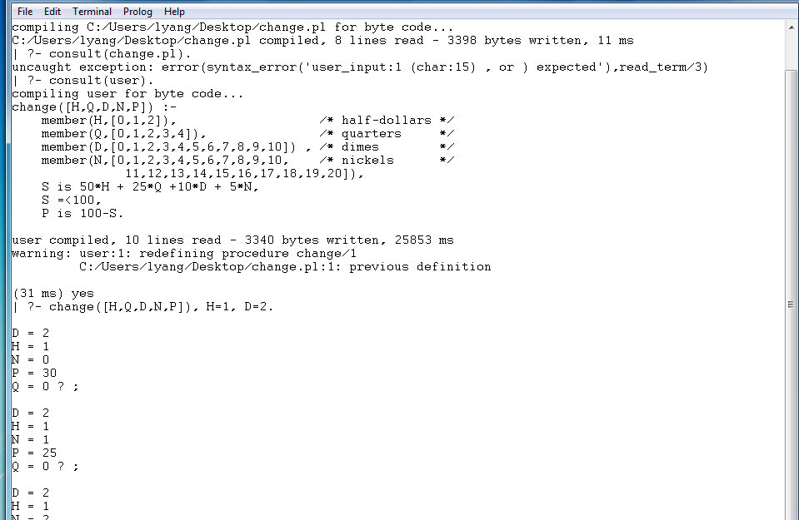

Slide 21
TRACE & SPY
len([],0).
len([X|Y],N) :- len(Y,M), N is M+1.
len([], N).
N=0.
len([a,b,c], N).
N=3.

Slide 22
?- trace.
true.
[trace] ?- len([1,3,a],S).
Call: (8) len([1, 3, a], _7828) ? creep
Call: (9) len([3, a], _8064) ? creep
Call: (10) len([a], _8064) ? creep
Call: (11) len([], _8064) ? creep
Exit: (11) len([], 0) ? creep
Call: (11) _8068 is 0+1 ? creep
Exit: (11) 1 is 0+1 ? creep
Exit: (10) len([a], 1) ? creep
Call: (10) _8074 is 1+1 ? creep
Exit: (10) 2 is 1+1 ? creep
Exit: (9) len([3, a], 2) ? creep
Call: (9) _7828 is 2+1 ? creep
Exit: (9) 3 is 2+1 ? creep
Exit: (8) len([1, 3, a], 3) ? creep
S = 3.
%turn off trace
[trace] ?- notrace.
true.

Slide 23
?- spy(len).
% Spy point on len/2
true.
[debug] ?- len([a,b,c],N).
* Call: (8) len([a, b, c], _7828) ? creep
* Call: (9) len([b, c], _8066) ? creep
* Call: (10) len([c], _8066) ? creep
* Call: (11) len([], _8066) ? creep
* Exit: (11) len([], 0) ? creep
Call: (11) _8070 is 0+1 ? creep
Exit: (11) 1 is 0+1 ? creep
* Exit: (10) len([c], 1) ? creep
Call: (10) _8076 is 1+1 ? creep
Exit: (10) 2 is 1+1 ? creep
* Exit: (9) len([b, c], 2) ? creep
Call: (9) _7828 is 2+1 ? creep
Exit: (9) 3 is 2+1 ? creep
* Exit: (8) len([a, b, c], 3) ? creep
N = 3.
%to end spy
[trace] ?- nospy(len).
% Spy point removed from len/2
true.

Slide 24
Practice
Append two lists
%append(Xs,Ys,Zs): Zs=append(Xs,Yx)
write your code here
2. Finding the last element of the list
3. Reversing a list
4. Quick sort (or any other sort)

Slide 25
Check if all atoms
all atoms (aa)
aa([a,b,c]) -> true
aa([a,2,c]) -> false
aa([a,[b,c],d]) -> false
Write your code

Slide 26
Find all pairs with numbers 0,1,2
?- pair(L).
L = [0,0] ;
L = [0,1] ;
L = [0,2] ;
L = [1,0] ;
L = [1,1] ;
L = [1,2] ;
L = [2,0] ;
L = [2,1] ;
L = [2,2] ;
false
Write your code for pair(L).

Slide 27
What about with no duplicates?
?- pair(L).
L = [0,1] ;
L = [0,2] ;
L = [1,0] ;
L = [1,2] ;
L = [2,0] ;
L = [2,1] ;
false

Slide 28
Challenge Problem
On telephone dial pad, numbers are matched with letters, say 2->A,B,C; 3->D, E, F, …
For number 277, what are possible letter combinations (i.e. mnemonics)?
E.g. CPP, CPR, APR, …
Actually it’s easy to solve this problem in prolog.

